Slide 1
Computer Systems Programming

Slide 2
About the course
This course gives you an overview of how computer systems are organized
This course provides skills and knowledge of C and how C is translated into assembly code, and how assembly code is executed in hardware

Slide 3
Course information
Home page
  Course objectives
  Updated course schedule
  Information about instructor, TA, office hours, textbooks
  Information about homeworks and submission instructions
D2L site
  d2l.pdx.edu
  All homework submissions
Slack
  pdx-cs.slack.com (#new_beginnings)
  Announcements, hints, help, class discussion

Slide 4
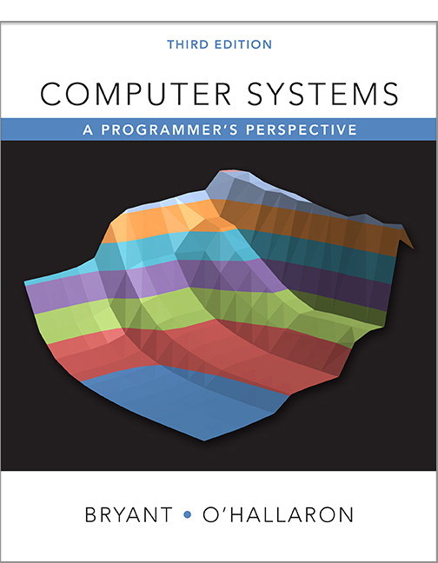
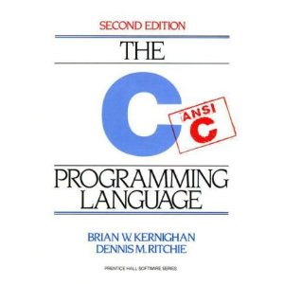
Textbooks
Required
  Randal E. Bryant and David R. O’Hallaron,
    “Computer Systems: A Programmer’s Perspective”, Prentice Hall 2015, 3rd edition.
    csapp.cs.cmu.edu
    All slide materials in this class are based on material provided by Bryant and O’Hallaron
Recommended
  Brian Kernighan and Dennis Ritchie,
    “The C Programming Language, Second Edition”, Prentice Hall, 1988
    Some parts of the course rely on the C99 standard

Slide 5
Exams
2 exams (midterm and final)
  Closed book
  Closed notes
  No electronics of any kind
  Taken from problems in the textbook and in class (See lecture slides and web site for list of problems)
  practice201.oregonctf.org

Slide 6
Accounts
Activation and access
  All programs must run on the CS Linux Lab machines
  Instructions for account setup and program submission on course web page
  Login remotely or in person (Basement of EB)‏
    Linux systems in FAB 88-09, 88-10
      linux.cs.pdx.edu
    Remote access via Linux or MacOS ssh
      ssh user@linux.cs.pdx.edu
    Remote access via Windows Putty
      http://www.chiark.greenend.org.uk/~sgtatham/putty
    Remote access via Cygwin ssh
      http://www.cygwin.com

Slide 7
Linux environment
Can also install local Linux virtual machine via VirtualBox
  http://thefengs.com/wuchang/courses/ubuntu_virtualbox.txt
Learn how to use Linux commands
  Helpful CTF: http://overthewire.org/wargames/bandit/
Linux commands to learn
  Filesystem
    ls, cd, mkdir, rm
  An editor (pick one)
    vim, nano, subl, emacs, gedit
  Homework tools
    gcc (GNU compiler)
    gdb (GNU debugger)
    make (Simple code building tool)
    zip (Archiver, compressor)

Slide 8
Assignments
Reading assignments posted with each lecture
Programming assignments and CTF
  See web site for grading breakdown
Homework assignments due at start of class on due date

Slide 9
Assignment 1
The specification is on course web site
  Scroll down to the weekly schedule, click on “A1”
  Submission via Bitbucket
  Makefile required
  TA will run and read your program
    Code should be modular
    Code should be concise and readable
    Have consistent naming conventions
    Be commented (including descriptions of variables, function parameters, and function return values)
      https://www.stack.nl/~dimitri/doxygen/manual/docblocks.html

Slide 10
Academic integrity
Policy
  Automatic failing grade given
  Departmental guidelines available in CS office
What is not cheating?
  Discussing the design for a program is OK.
  Helping each other orally (not in writing) is OK.
  Using anything out of the textbook or my slides is OK.
  Copying code “snippets”, templates for library calls, or declarations from a reference book or header files are OK
What is cheating?
  Copying code verbatim without attribution
  Copying someone’s answer or letting someone copy your answer

Slide 11
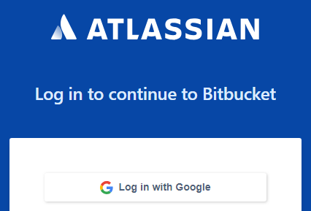
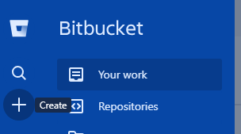
Bitbucket
Create an account on Bitbucket
Log out of all of your Google accounts
Go to https://bitbucket.org
  Use your @pdx.edu e-mail address to "Login with Google"
  Find the + and click on it to create a new repository
    Name your repository
      nb-<FirstName>-<LastName>
      (e.g. nb-Wuchang-Feng)
    Then "Create repository" using default options
  Pause
    We will create a git repo on linux.cs.pdx.edu then, connect it up to this repository

Slide 12
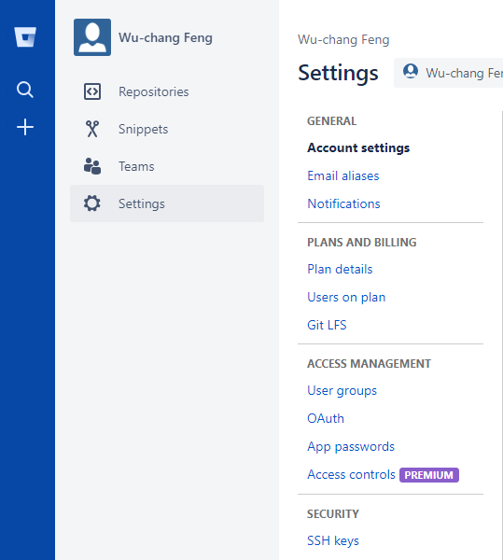
Bitbucket
Set-up ssh key access from linux.cs.pdx.edu (for convenience)
  If you have not set-up an ssh key before, run:
      ssh-keygen -t rsa
  Copy the contents of ~/.ssh/id_rsa.pub to the clipboard
  Go back to Bitbucket and access your profile
  In Settings, click "SSH keys", then "Add key"

Slide 13
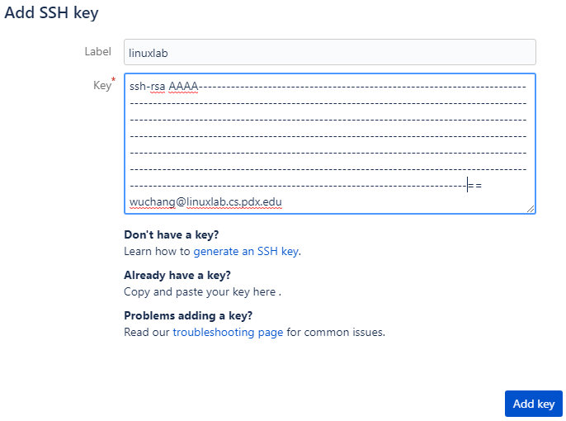
Bitbucket
Add ssh key from linux.cs.pdx.edu
  https://confluence.atlassian.com/bitbucket/set-up-an-ssh-key-728138079.html

Slide 14
Bitbucket
  Then, clone repo from linux.cs.pdx.edu using the ssh key added
    Example:
  git clone ssh://git@bitbucket.org/wuchangfeng/nb-wuchang-feng
  Change directories into your repo (cd nb-wuchang-feng)
    Create a file README.md with an initial message
    Add it to the files you would like to commit permanently into local repository
      git add README.md
    Commit the file permanently into local repository with a short message describing the commit
      Push the local repository onto the origin repository on the master branch
      git commit -m "First commit"
    Push the local repository onto the origin repository on the master branch
      git push -u origin master
  Go back to the new repository on Bitbucket and find "Send invitation"
    Add course instructor and TA with read access (wuchangfeng , sastrand)

Slide 15
Bitbucket
  Read the first 6 steps of https://product.hubspot.com/blog/git-and-github-tutorial-for-beginners
    git clone
      Fetch a copy of a remote repository
    git add
      Add a new file and/or directory to local repository
    git commit
      Commit changes to local repository
    git push
      Merge changes from local repository to a remote one
      Implicitly assumes "origin" (place that you retrieved repo from) and "master" (branch)
    git pull
      Merge changes from remote repository to your local one
      Implicitly assumes "origin" (place that you retrieved repo from) and "master" (branch)

Slide 16
Bitbucket
  Create a directory called hw1 within local repository (mkdir hw1)
  Within the directory
    Create a markdown file called README.md that contains a colorful message to me that shows me how much Markdown you know
      cd hw1; vim README.md
  Add the directory and files to your repo via git add .
  Commit the changes locally via git commit
  Push the changes to your remote BitBucket repo via git push

Slide 17
Bitbucket
Note: All code submissions will be via Bitbucket
  Commit changes to your repository frequently
  Use descriptive messages in commit messages
  Create a tag for your repository for each homework submitted
    Tags named hw1, hw2, hw3, … etc.
Other resources
  http://rogerdudler.github.io/git-guide/
  https://confluence.atlassian.com/bitbucketserver/basic-git-commands-776639767.html

Slide 18
Help
CS Tutors
Instructor and TA office hours
Slack channel
Anonymous feedback at https://sayat.me/wu4f

