Slide 1
Memory Hierarchy II

Slide 2
Last class
Caches
Direct mapped
E=1 (One cache line per set)
Each main memory address can be placed in exactly one place in the cache
Conflict misses if two addresses map to same place in direct-mapped cache
Set-associative
Multiple cache lines per set
Reduce conflict misses
Increase complexity/cost of cache

Slide 3
A fully associative cache
A fully associative cache permits data to be stored in any cache block, instead of forcing each memory address into one particular block.
There is only 1 set (i.e. S=1 and s=0)
C = E*B
When data is fetched from memory, it can be placed in any unused block of the cache.
Eliminates conflict misses between two or more memory addresses which map to a single cache block.

Slide 4
Fully associative cache example
Consider the following fully associative cache: (S,E,B,m) = (1,4,1,4)
Derive values for number of address bits used for the tag (t), the index (s) and the block offset (b)
Draw a diagram of which bits of the address are used for the tag, the set index and the block offset
Draw a diagram of the cache
s = 0
b = 0
t = 4
t (4 bits)
Tag
Data
Tag
Data
Tag
Data
Tag
Data
s=0
4 bits | 1 byte
4 bits | 1 byte
4 bits | 1 byte
4 bits | 1 byte

Slide 5
Fully associative cache (S,E,B,m) = (1,4,1,4)
Cache
0000 0x00
0001 0x11
0010 0x22
0011 0x33
0100 0x44
0101 0x55
0110 0x66
0111 0x77
1000 0x88
1001 0x99
1010 0xAA
1011 0xBB
1100 0xCC
1101 0xDD
1110 0xEE
1111 0xFF
Data
Tag
Data
Tag
Data
Tag
Data
Access pattern:
0010
0110
0010
0110
0010
0110
…
t (4 bits)

Slide 6
Fully associative cache (S,E,B,m) = (1,4,1,4)
Main memory
Cache
0000 0x00
0001 0x11
0010 0x22
0011 0x33
0100 0x44
0101 0x55
0110 0x66
0111 0x77
1000 0x88
1001 0x99
1010 0xAA
1011 0xBB
1100 0xCC
1101 0xDD
1110 0xEE
1111 0xFF
Tag
Data
Tag
Data
Tag
Data
Tag
Data
0010 | 0x22
Access pattern:
0010
0110
0010
0110
0010
0110
…
Cache miss
t (4 bits)

Slide 7
Fully associative cache (S,E,B,m) = (1,4,1,4)
Main memory
Cache
0000 0x00
0001 0x11
0010 0x22
0011 0x33
0100 0x44
0101 0x55
0110 0x66
0111 0x77
1000 0x88
1001 0x99
1010 0xAA
1011 0xBB
1100 0xCC
1101 0xDD
1110 0xEE
1111 0xFF
Tag
Data
Tag
Data
Tag
Data
Tag
Data
0010 | 0x22
0110 | 0x66
Access pattern:
0010
0110
0010
0110
0010
0110
…
Cache miss
t (4 bits)

Slide 8
Fully associative cache (S,E,B,m) = (1,4,1,4)
Main memory
Cache
0000 0x00
0001 0x11
0010 0x22
0011 0x33
0100 0x44
0101 0x55
0110 0x66
0111 0x77
1000 0x88
1001 0x99
1010 0xAA
1011 0xBB
1100 0xCC
1101 0xDD
1110 0xEE
1111 0xFF
Tag
Data
Tag
Data
Tag
Data
Tag
Data
0010 | 0x22
0110 | 0x66
Access pattern:
0010
0110
0010
0110
0010
0110
…
Cache hit
t (4 bits)

Slide 9
Fully associative cache (S,E,B,m) = (1,4,1,4)
Main memory
Cache
0000 0x00
0001 0x11
0010 0x22
0011 0x33
0100 0x44
0101 0x55
0110 0x66
0111 0x77
1000 0x88
1001 0x99
1010 0xAA
1011 0xBB
1100 0xCC
1101 0xDD
1110 0xEE
1111 0xFF
Tag
Data
Tag
Data
Tag
Data
Tag
Data
0010 | 0x22
0110 | 0x66
Access pattern:
0010
0110
0010
0110
0010
0110
…
Cache hit
t (4 bits)

Slide 10
Fully associative cache (S,E,B,m) = (1,4,1,4)
Main memory
Cache
0000 0x00
0001 0x11
0010 0x22
0011 0x33
0100 0x44
0101 0x55
0110 0x66
0111 0x77
1000 0x88
1001 0x99
1010 0xAA
1011 0xBB
1100 0xCC
1101 0xDD
1110 0xEE
1111 0xFF
Tag
Data
Tag
Data
Tag
Data
Tag
Data
0010 | 0x22
0110 | 0x66
Access pattern:
0010
0110
0010
0110
0010
0110
…
Cache hit
t (4 bits)

Slide 11
Fully associative cache (S,E,B,m) = (1,4,1,4)
Main memory
Cache
0000 0x00
0001 0x11
0010 0x22
0011 0x33
0100 0x44
0101 0x55
0110 0x66
0111 0x77
1000 0x88
1001 0x99
1010 0xAA
1011 0xBB
1100 0xCC
1101 0xDD
1110 0xEE
1111 0xFF
0000 0x00
0001 0x11
0010 0x22
0011 0x33
0100 0x44
0101 0x55
0110 0x66
0111 0x77
1000 0x88
1001 0x99
1010 0xAA
1011 0xBB
1100 0xCC
1101 0xDD
1110 0xEE
1111 0xFF
Tag
Data
Tag
Data
Tag
Data
Tag
Data
0010 | 0x22
0110 | 0x66
Access pattern:
0010
0110
0010
0110
0010
0110
…
Cache hit
Miss rate after first two cold misses =
0%

Slide 12
The price of full associativity
However, a fully associative cache is expensive to implement.
No index field in the address anymore
Entire address used as the tag, increasing the total cache size.
Data could be anywhere in the cache, so we must check the tag of every cache block. That’s a lot of comparators!
Address (32 bits)
Index
Valid
Tag (32 bits)
Data
...
...
...
32
Tag
=
=
Hit
=

Slide 13
Cache design
So far
C = Size
S = Number of sets
E = Number of lines per set (associativity)
B = Block size
Replacement Algorithm
Write Policy
Number of Caches

Slide 14
Replacement algorithms
Any empty block in the correct set may be used for storing data.
If there are no empty blocks, the cache will attempt to replace one
Most common LRU (least recently used)
Assuming a block hasn’t been used in a while, it won’t be needed again anytime soon.
Others
First in first out (FIFO)
replace block that has been in cache longest
Least frequently used
replace block which has had fewest hits
Random

Slide 15
LRU example
Assume a fully-associative cache with two blocks, which of the following memory references miss in the cache.
assume distinct addresses go to distinct blocks
addresses
0
Tags
1
LRU
--
--
0
A
A
--
A
B
A
B
A
A
A
B
B
h
C
A
C
A
B
B
C
C
A
B
A
B
B
B
A
A
h

Slide 16
2-way set associative LRU cache (S,E,B,m) = (2,2,1,4)
Main memory
Cache
0000 0x00
0001 0x11
0010 0x22
0011 0x33
0100 0x44
0101 0x55
0110 0x66
0111 0x77
1000 0x88
1001 0x99
1010 0xAA
1011 0xBB
1100 0xCC
1101 0xDD
1110 0xEE
1111 0xFF
Set
Tag
Data
Tag
Data
0
1
Access pattern:
0010
0110
0010
0000
0010
0110
…
t (3 bits)
s (1 bit)

Slide 17
2-way set associative LRU cache (S,E,B,m) = (2,2,1,4)
Main memory
Cache
0000 0x00
0001 0x11
0010 0x22
0011 0x33
0100 0x44
0101 0x55
0110 0x66
0111 0x77
1000 0x88
1001 0x99
1010 0xAA
1011 0xBB
1100 0xCC
1101 0xDD
1110 0xEE
1111 0xFF
Set
Tag
Data
Tag
Data
0
001 | 0x22
1
Access pattern:
0010
0110
0010
0000
0010
0110
…
Cache miss
t (3 bits)
s (1 bit)

Slide 18
2-way set associative LRU cache (S,E,B,m) = (2,2,1,4)
Main memory
Cache
0000 0x00
0001 0x11
0010 0x22
0011 0x33
0100 0x44
0101 0x55
0110 0x66
0111 0x77
1000 0x88
1001 0x99
1010 0xAA
1011 0xBB
1100 0xCC
1101 0xDD
1110 0xEE
1111 0xFF
Set
Tag
Data
Tag
Data
0
001 | 0x22
011 | 0x66
1
Access pattern:
0010
0110
0010
0000
0010
0110
…
Cache miss
t (3 bits)
s (1 bit)

Slide 19
2-way set associative LRU cache (S,E,B,m) = (2,2,1,4)
Main memory
Cache
0000 0x00
0001 0x11
0010 0x22
0011 0x33
0100 0x44
0101 0x55
0110 0x66
0111 0x77
1000 0x88
1001 0x99
1010 0xAA
1011 0xBB
1100 0xCC
1101 0xDD
1110 0xEE
1111 0xFF
Set
Tag
Data
Tag
Data
0
001 | 0x22
011 | 0x66
1
Access pattern:
0010
0110
0010
0000
0010
0110
…
Cache hit
t (3 bits)
s (1 bit)

Slide 20
2-way set associative LRU cache (S,E,B,m) = (2,2,1,4)
Main memory
Cache
0000 0x00
0001 0x11
0010 0x22
0011 0x33
0100 0x44
0101 0x55
0110 0x66
0111 0x77
1000 0x88
1001 0x99
1010 0xAA
1011 0xBB
1100 0xCC
1101 0xDD
1110 0xEE
1111 0xFF
Set
Tag
Data
Tag
Data
0
001 | 0x22
000 | 0x00
1
Access pattern:
0010
0110
0010
0000
0010
0110
…
Cache miss (replace LRU)
t (3 bits)
s (1 bit)

Slide 21
2-way set associative LRU cache (S,E,B,m) = (2,2,1,4)
Main memory
Cache
0000 0x00
0001 0x11
0010 0x22
0011 0x33
0100 0x44
0101 0x55
0110 0x66
0111 0x77
1000 0x88
1001 0x99
1010 0xAA
1011 0xBB
1100 0xCC
1101 0xDD
1110 0xEE
1111 0xFF
Set
Tag
Data
Tag
Data
0
001 | 0x22
000 | 0x00
1
Access pattern:
0010
0110
0010
0000
0010
0110
…
Cache hit
t (3 bits)
s (1 bit)

Slide 22
2-way set associative LRU cache (S,E,B,m) = (2,2,1,4)
Main memory
Cache
0000 0x00
0001 0x11
0010 0x22
0011 0x33
0100 0x44
0101 0x55
0110 0x66
0111 0x77
1000 0x88
1001 0x99
1010 0xAA
1011 0xBB
1100 0xCC
1101 0xDD
1110 0xEE
1111 0xFF
Set
Tag
Data
Tag
Data
0
001 | 0x22
011 | 0x66
1
Access pattern:
0010
0110
0010
0000
0010
0110
…
Cache miss
t (3 bits)
s (1 bit)

Slide 23
Write-policies
What happens when data is written to memory through cache
Two cases
Write-hit: Block being written is in cache
Write-miss: Block being written is not in cache

Slide 24
Write-hit policies
Write-through
Writes go immediately to main memory (as well as cache)
Multiple cores/CPUs can monitor main memory traffic to keep caches consistent and up to date
Lots of traffic
Slows down writes
Write-back
Writes initially made in cache only
Defer write to memory until replacement of line
Use a dirty bit to indicate cache entry that has been updated
If block is to be replaced, write to main memory only if dirty bit is set
Other caches can get out of sync
Some CPUs allow one to set the cache policy for a particular program or memory page

Slide 25
Write miss policies
Write-allocate
When write to address misses, load into cache
Update line in cache
Good if there are subsequent reads and writes to address
No write-allocate
When write to address misses, bypass cache and write straight to memory
Do not load into cache
Good if there are no subsequent reads and writes to address
Typically,
Write-through policy paired with no-write-allocate policy
Write-back policy paired with write-allocate policy

Slide 26
Number of caches
As logic density increases, it has become advantageous and practical to create deeper multi-level caches:
on chip
off chip
Previously, deepening the hierarchy
Pentium II: L1 (on chip) & L2 (off chip)
Pentium III: L1 and L2 (on-chip), L3 (off chip)
Intel Core: L1 and L2 per core (on-chip), Unified L3 (on-chip)

Slide 27
Number of caches
Another way: Split caches based on what they store
Data cache
Instruction cache
Advantage:
Likely increased hit rates – data and program accesses display different behavior
Disadvantage
Complexity

Slide 28
Intel Pentium cache hierarchy
Separate data and instruction caches vs. unified cache
Intel Pentium Cache Hierarchy
Processor Chip
L1 Data
1 cycle latency
16 KB
4-way assoc
Write-through
32B lines
Regs.
L2 Unified
128KB--2 MB
4-way assoc
Write-back
Write allocate
32B lines
Main
Memory
Up to 4GB
L1 Instruction
16 KB, 4-way
32B lines

Slide 29
Intel Core i7 cache hierarchy (2014)
Separate data and instruction caches vs. unified cache
Processor package
Core 0
Core 3
16 (rax, rbx…)
Regs
Regs
32kB each
L1
d-cache
L1
i-cache
…
L1
d-cache
L1
i-cache
256kB
L2 unified cache
L2 unified cache
2-20MB
L3 unified cache
(shared by all cores)
L4* 128 MB (Iris Pro)
Main memory

Slide 30
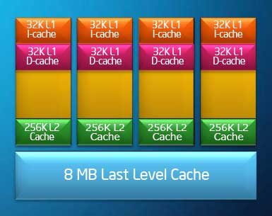
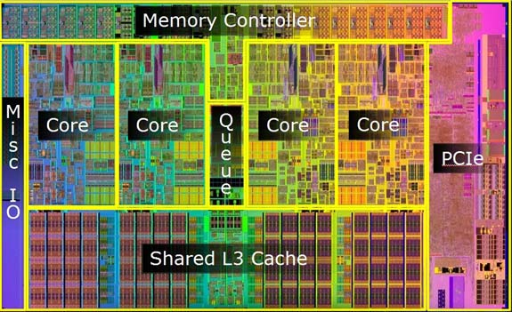
Intel Core i7 cache hierarchy

Slide 31
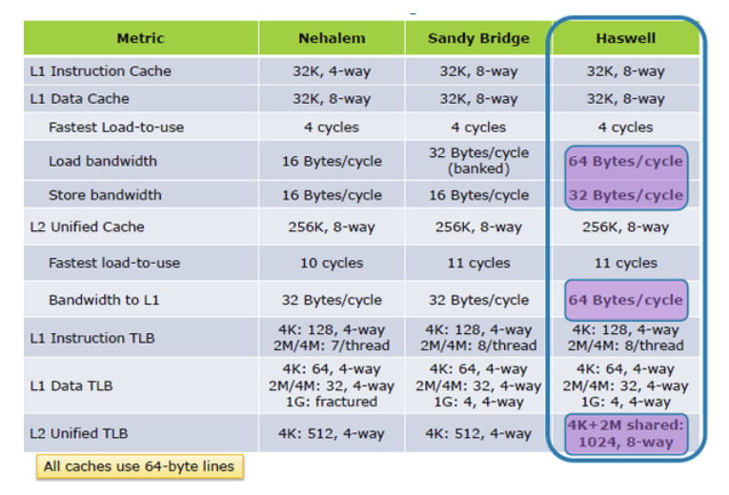
Querying cache parameters
Exposed via CPUID x86 instruction
getconf –a | egrep LEVEL
grep . /sys/devices/system/cpu/cpu0/cache/index*/*

Slide 32
Memory Mountain
Measuring memory performance of a system
Metric used: Read throughput (read bandwidth)
Number of bytes read from memory per second (MB/s)
Measured read throughput is a function of spatial and temporal locality.
Compact way to characterize memory system performance
Two parameters
Size of data set (elems)
Access stride length (stride)

Slide 33
Memory mountain test function
long data[MAXELEMS]; /* Global array to traverse */
/* test - Iterate over first "elems" elements of
* array “data” with stride of "stride", using
* using 4x4 loop unrolling.
*/
int test(int elems, int stride) {
long i, sx2=stride*2, sx3=stride*3, sx4=stride*4;
long acc0 = 0, acc1 = 0, acc2 = 0, acc3 = 0;
long length = elems, limit = length - sx4;
/* Combine 4 elements at a time */
for (i = 0; i < limit; i += sx4) {
acc0 = acc0 + data[i];
acc1 = acc1 + data[i+stride];
acc2 = acc2 + data[i+sx2];
acc3 = acc3 + data[i+sx3];
}
/* Finish any remaining elements */
for (; i < length; i++) {
acc0 = acc0 + data[i];
}
return ((acc0 + acc1) + (acc2 + acc3));
}

Slide 34
Memory Mountain results
Core i7 Haswell
2.1 GHz
32 KB L1 d-cache
256 KB L2 cache
8 MB L3 cache
64 B block size
L1
Ridges
of temporal locality
L2
L3
Slopes
of spatial locality
Mem

Slide 35
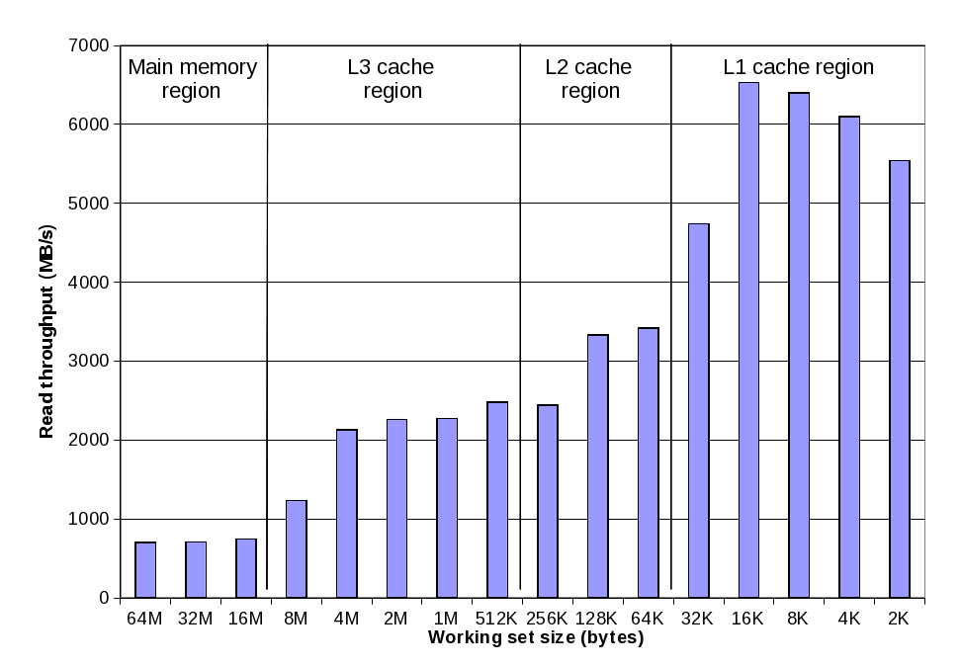
Ridges of Temporal Locality
Slice through the memory mountain with stride=16 multiple times across different working set sizes
Get read throughputs of different caches and memory

Slide 36
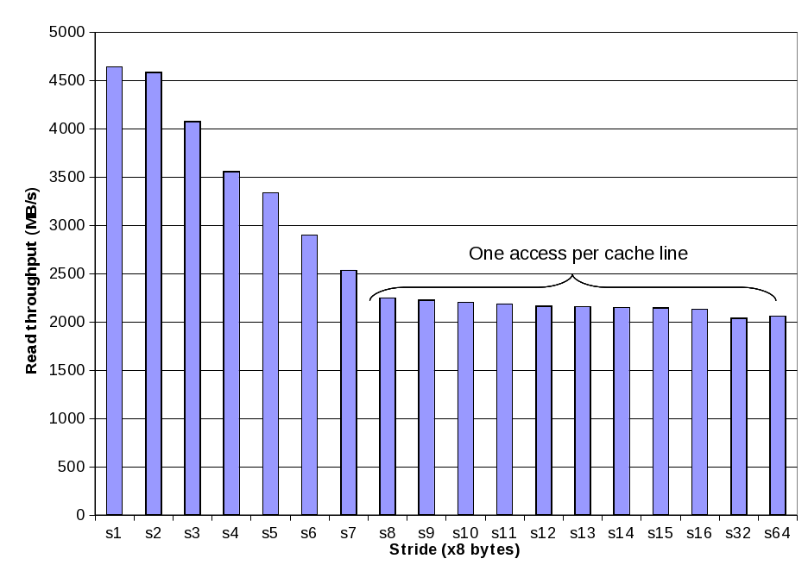
A Slope of Spatial Locality
Slice through memory mountain with size=4MB using different strides
Reveals the cache block size.

Slide 37
Matrix Multiplication Example
Writing memory efficient code
Cache effects to consider
Total cache size
Exploit temporal locality and keep the working set small
Block size
Exploit spatial locality
Description:
Multiply N x N matrices
O(N³) total operations
Accesses
N reads per source element
N values summed per destination
but may be able to hold in register
Variable sum
held in register
/* ijk */
for (i=0; i<n; i++) {
for (j=0; j<n; j++) {
sum = 0.0;
for (k=0; k<n; k++)
sum += a[i][k] * b[k][j];
c[i][j] = sum;
}
}

Slide 38
Miss Rate Analysis for Matrix Multiply
Assume:
Double-precision floating point numbers
Line size = 32 bytes (big enough for 4 8-byte doubles)
Matrix dimension (N) is very large
Approximate 1/N as 0.0
Cache is not even big enough to hold multiple rows
Analysis Method:
Look at access pattern of inner loop
k
j
j
i
k
i
A
B
C

Slide 39
Layout of C Arrays in Memory (review)
C arrays allocated in row-major order
each row in contiguous memory locations
Stepping through columns in one row:
for (i = 0; i < N; i++)
sum += a[0][i];
accesses successive elements
Stepping through rows in one column:
for (i = 0; i < n; i++)
sum += a[i][0];
accesses distant elements
no spatial locality!
compulsory miss rate = 1 (i.e. 100%)

Slide 40
Matrix Multiplication (ijk)
/* ijk */
for (i=0; i<n; i++) {
for (j=0; j<n; j++) {
sum = 0.0;
for (k=0; k<n; k++)
sum += a[i][k] * b[k][j];
c[i][j] = sum;
}
}
Inner loop:
(*,j)
(i,j)
(i,*)
A
B
C
Row-wise
Column-
wise
Fixed
Miss rate per Inner Loop Iteration:
A B C
0.25 1.0 0.0

Slide 41
Matrix Multiplication (jik)
/* jik */
for (j=0; j<n; j++) {
for (i=0; i<n; i++) {
sum = 0.0;
for (k=0; k<n; k++)
sum += a[i][k] * b[k][j];
c[i][j] = sum
}
}
Inner loop:
(*,j)
(i,j)
(i,*)
A
B
C
Row-wise
Column-
wise
Fixed
Miss rate per Inner Loop Iteration:
A B C
0.25 1.0 0.0

Slide 42
Matrix Multiplication (kij)
/* kij */
for (k=0; k<n; k++) {
for (i=0; i<n; i++) {
r = a[i][k];
for (j=0; j<n; j++)
c[i][j] += r * b[k][j];
}
}
Inner loop:
(i,k)
(k,*)
(i,*)
A
B
C
Fixed
Row-wise
Row-wise
Miss rate per Inner Loop Iteration:
A B C
0.0 0.25 0.25
Better read performance, but now incur a memory store per iteration

Slide 43
Matrix Multiplication (ikj)
/* ikj */
for (i=0; i<n; i++) {
for (k=0; k<n; k++) {
r = a[i][k];
for (j=0; j<n; j++)
c[i][j] += r * b[k][j];
}
}
Inner loop:
(i,k)
(k,*)
(i,*)
A
B
C
Fixed
Row-wise
Row-wise
Miss rate per Inner Loop Iteration:
A B C
0.0 0.25 0.25

Slide 44
Matrix Multiplication (jki)
/* jki */
for (j=0; j<n; j++) {
for (k=0; k<n; k++) {
r = b[k][j];
for (i=0; i<n; i++)
c[i][j] += a[i][k] * r;
}
}
Inner loop:
(*,k)
(*,j)
(k,j)
A
B
C
Column -
wise
Fixed
Column-
wise
Miss rate per Inner Loop Iteration:
A B C
1.0 0.0 1.0

Slide 45
Matrix Multiplication (kji)
/* kji */
for (k=0; k<n; k++) {
for (j=0; j<n; j++) {
r = b[k][j];
for (i=0; i<n; i++)
c[i][j] += a[i][k] * r;
}
}
Inner loop:
(*,k)
(*,j)
(k,j)
A
B
C
Column-
wise
Fixed
Column-
wise
Miss rate per Inner Loop Iteration:
A B C
1.0 0.0 1.0

Slide 46
Summary of Matrix Multiplication
ijk (& jik):
2 loads, 0 stores
misses/iter = 1.25
kij (& ikj):
2 loads, 1 store
misses/iter = 0.5
jki (& kji):
2 loads, 1 store
misses/iter = 2.0
for (i=0; i<n; i++) {
for (j=0; j<n; j++) {
sum = 0.0;
for (k=0; k<n; k++)
sum += a[i][k] * b[k][j];
c[i][j] = sum;
}
}
for (k=0; k<n; k++) {
for (i=0; i<n; i++) {
r = a[i][k];
for (j=0; j<n; j++)
c[i][j] += r * b[k][j];
}
}
for (j=0; j<n; j++) {
for (k=0; k<n; k++) {
r = b[k][j];
for (i=0; i<n; i++)
c[i][j] += a[i][k] * r;
}
}

Slide 47
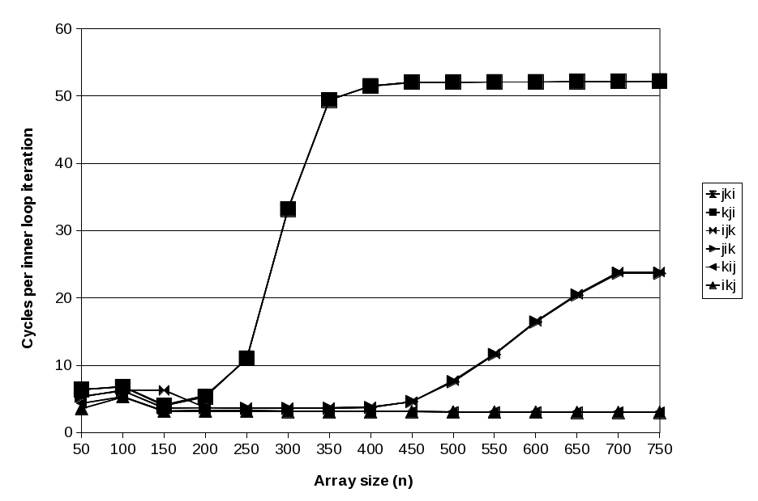
Intel Core i7 Matrix Multiply Performance

Slide 48
Matrix multiplication performance
Spatial locality issues addressed previously
Temporal locality not addressed, but size of matrices makes leveraging temporal locality difficult
How can one address this?

Slide 49
Improving Temporal Locality by Blocking
Example: Blocked matrix multiplication
“block” (in this context) does not mean “cache block”.
Instead, it means a sub-block within the matrix.
Example: N = 8; sub-block size = 4
A₁₁ A₁₂
A₂₁ A₂₂
B₁₁ B₁₂
B₂₁ B₂₂
C₁₁ C₁₂
C₂₁ C₂₂
X
=
Key idea: Sub-blocks (i.e., A_{xy}) can be treated just like scalars.
C₁₁ = A₁₁B₁₁ + A₁₂B₂₁ C₁₂ = A₁₁B₁₂ + A₁₂B₂₂
C₂₁ = A₂₁B₁₁ + A₂₂B₂₁ C₂₂ = A₂₁B₁₂ + A₂₂B₂₂

Slide 50
Blocked Matrix Multiply (bijk)
for (jj=0; jj<n; jj+=bsize) {
for (i=0; i<n; i++)
for (j=jj; j < min(jj+bsize,n); j++)
c[i][j] = 0.0;
for (kk=0; kk<n; kk+=bsize) {
for (i=0; i<n; i++) {
for (j=jj; j < min(jj+bsize,n); j++) {
sum = 0.0
for (k=kk; k < min(kk+bsize,n); k++) {
sum += a[i][k] * b[k][j];
}
c[i][j] += sum;
}
}
}
}

Slide 51
Blocked Matrix Multiply Analysis
Innermost loop pair multiplies a 1 X bsize sliver of A by a bsize X bsize block of B and accumulates into 1 X bsize sliver of C
Loop over i steps through n row slivers of A & C, using same B
for (i=0; i<n; i++) {
for (j=jj; j < min(jj+bsize,n); j++) {
sum = 0.0
for (k=kk; k < min(kk+bsize,n); k++) {
sum += a[i][k] * b[k][j];
}
c[i][j] += sum;
}
Innermost
Loop Pair
kk
jj
jj
kk
i
i
A
B
C
row sliver accessed
bsize times
Update successive
elements of sliver
block reused n times in succession

Slide 52
Pentium Blocked Matrix Multiply Performance
Blocking (bijk and bikj) improves performance by a factor of two over unblocked versions (ijk and jik)
relatively insensitive to array size.

Slide 53
Concluding Observations
Programmer can optimize for cache performance
How data structures are organized
How data are accessed
Nested loop structure
Blocking is a general technique
All systems favor “cache friendly code”
Getting absolute optimum performance is very platform specific
Cache sizes, line sizes, associativities, etc.
Can get most of the advantage with generic code
Keep working set reasonably small (temporal locality)
Use small strides (spatial locality)

Slide 54
Extra

Slide 55
Exam practice
Chapter 6 Problems
6.7, 6.8 Stride-1 access in C
6.9 Cache parameters
6.10 Cache performance
6.11 Cache capacity
6.12, 6.13, 6.14, 6.15 Cache lookup
6.16 Cache address mapping
6.18 Cache simulation

Slide 56
Practice problem 6.15
Consider a 2-way set associative cache (S,E,B,m) = (8,2,4,13)
Note: Invalid cache lines are left blank
Consider an access to 0x1FE4.
What is the block offset of this address in hex?
What is the set index of this address in hex?
What is the cache tag of this address in hex?
Does this access hit or miss in the cache?
What value is returned if it is a hit?
Set
Tag
Data0-3
Tag
Data0-3
0
1
2
3
4
5
6
7
09 | 86 30 3F 10
45 | 60 4F E0 23
EB
06
C7 | 06 78 07 C5
71 | 0B DE 18 4B
91 | A0 B7 26 2D
46
00
38 | 00 BC 0B 37
0B
32 | 12 08 7B AD
05 | 40 67 C2 3B
6E
F0
DE | 12 C0 88 37
0x0
0x1
0xFF
Miss
t (8 bits)
s (3 bits)
b (2 bits)

Slide 57
Writing Cache Friendly Code
Repeated references to variables are good (temporal locality)
Stride-1 reference patterns are good (spatial locality)
Revisiting example
cold cache, 4-byte words, 4-word cache blocks
int sumarrayrows(int a[M][N])
{
int i, j, sum = 0;
for (i = 0; i < M; i++)
for (j = 0; j < N; j++)
sum += a[i][j];
return sum;
}
int sumarraycols(int a[M][N])
{
int i, j, sum = 0;
for (j = 0; j < N; j++)
for (i = 0; i < M; i++)
sum += a[i][j];
return sum;
}
Miss rate =
1/4 = 25%
Miss rate =
100%

Slide 58
Typical Cache Performance
Miss Rate
Fraction of memory references not found in cache (misses/references) (1 – HitRate)
Typical numbers:
3-10% for L1
can be quite small (e.g., < 1%) for L2, depending on size, etc.
Hit Time
Time to deliver a line in the cache to the processor (includes time to determine whether the line is in the cache)
Typical numbers:
4 clock cycle for L1
10 clock cycles for L2
Miss Penalty
Additional time required because of a miss
Typically 50-200 cycles for main memory

Slide 59
Let’s think about those numbers
Huge difference between a hit and a miss
Could be 100x, if just L1 and main memory
Would you believe 99% hits is twice as good as 97%?
Consider: cache hit time of 1 cycle miss penalty of 100 cycles
Average access time:
97% hits: 1 cycle + 0.03 * 100 cycles = 4 cycles
99% hits: 1 cycle + 0.01 * 100 cycles = 2 cycles
This is why “miss rate” is used instead of “hit rate”

