Slide 1
C vs. Rust

Slide 2
C (the good parts)
Efficient code especially in resource-constrained environments
Direct control over hardware
Performance over safety
  Memory managed manually
  No periodic garbage collection
  Desirable for advanced programmers

Slide 3
But…
Type errors easy to make
  Integer promotion/coercion errors
  Unsigned vs. signed errors
  Integer casting errors

Slide 4
and…
Memory errors easy to make
  Null pointer dereferences
  Buffer overflows, out-of-bound access (no array-bounds checking)
  Format string errors
  Dynamic memory errors
    Memory leaks
    Use-after-free (dangling pointer)
    Double free
Cause software crashes and security vulnerabilities.

Slide 5
Example: C is good
Lightweight, low-level control of memory
typedef struct Dummy { int a; int b; } Dummy;
void foo(void) {
Dummy *ptr = (Dummy *) malloc(sizeof(struct Dummy));
ptr->a = 2048;
free(ptr);
}
Precise memory layout
Lightweight reference
Destruction
.a = 2048
.a
ptr
.b
Stack
Heap

Slide 6
Example: C is not so good
typedef struct Dummy { int a; int b; } Dummy;
void foo(void) {
Dummy *ptr = (Dummy *) malloc(sizeof(struct Dummy));
Dummy *alias = ptr;
free(ptr);
int a = alias.a;
free(alias);
}
Use after free
Aliasing
Mutation
Double free
Dangling Pointer
.a
ptr
.b
alias
Stack
Heap

Slide 7
Solved by managed languages
Java, Python, Ruby, C#, Scala, Go...
  Restrict direct access to memory
  Run-time management of memory via periodic garbage collection
  No explicit malloc and free, no memory corruption issues
  But
    Overhead of tracking object references
    Program behavior unpredictable due to GC (bad for real-time systems)
    Limited concurrency (global interpreter lock typical)
    Larger code size
    VM must often be included
    Needs more memory and CPU power (i.e. not bare-metal)

Slide 8
Requirements for system programs
Must be fast and have minimal runtime overhead
Should support direct memory access, but be memory -safe

Slide 9
Rust

Slide 10
Rust
From the official website (http://rust-lang.org):
Rust is a system programming language barely on hardware.
  No runtime requirement (runs fast)
  Control over memory allocation/destruction.
  Guarantees memory safety
  Developed to address severe memory leakage and corruption bugs in Firefox
  First stable release in 5/2015

Slide 11
Rust overview
Performance, as with C
  Rust compilation to object code for bare-metal performance
But, supports memory safety
  Programs dereference only previously allocated pointers that have not been freed
  Out-of-bound array accesses not allowed
With low overhead
  Compiler checks to make sure rules for memory safety are followed
  Zero-cost abstraction in managing memory (i.e. no garbage collection)
Via
  Advanced type system
  Ownership, borrowing, and lifetime concepts to prevent memory corruption issues
But at a cost
  Cognitive cost to programmers who must think more about rules for using memory and references as they program

Slide 12
Rust’s type system

Slide 13
Rust and typing
Primitive types
  bool
  char (4-byte unicode)
  i8/i16/i32/i64/isize
  u8/u16/u32/u64/usize
  f32/f64
Separate bool type
  C overloads an integer to get booleans
  Leads to varying interpretations in API calls
    True, False, or Fail? 1, 0, -1?
    Misinterpretations lead to security issues
    Example: PHP strcmp returns 0 for both equality *and* failure!
Numeric types specified with width
  Prevents bugs due to unexpected promotion/coercion/rounding

Slide 14
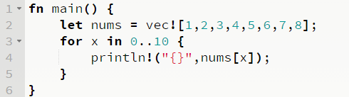
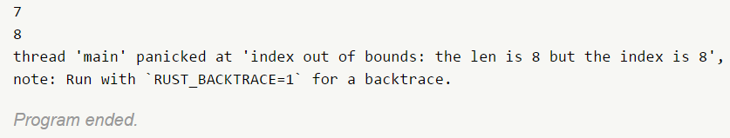
Rust and typing
Arrays stored with their length [T; N]
  Allows for both compile-time and run-time checks on array access via[]
C
Rust
void main(void) {
int nums[8] = {1,2,3,4,5,6,7,8};
for ( x = 0; x < 10; i++ )
printf(“%d\n”,nums[i]);
}

Slide 15
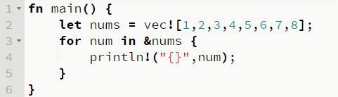
Rust and bounds checking
But…
  Checking bounds on every access adds overhead
  Arrays typically accessed via more efficient iterators
    Can use x86 loop instruction

Slide 16
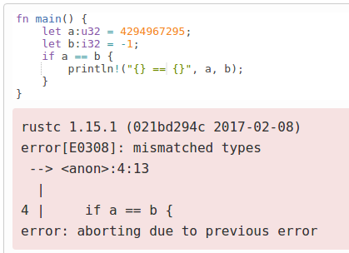
Rust vs C typing errors
Recall issues with implicit integer casts and promotion in C
  -1 > 0U
  2147483647U < -2147483648
Rust’s type system prevents such comparisons
int main() {
unsigned int a = 4294967295;
int b = -1;
if (a == b)
printf("%u == %d\n",a,b);
}
mashimaro <~> 9:44AM % ./a.out
4294967295 == -1

Slide 17
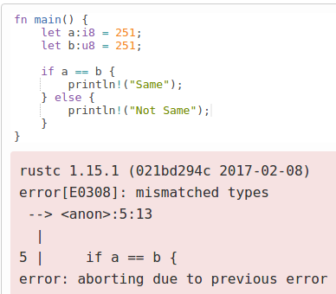
Rust vs C typing errors
Same or different?
int main() {
char a=251;
unsigned char b = 251;
printf("a = %x\n", a);
printf("b = %x\n", b);
if (a == b)
printf("Same\n");
else
printf("Not Same\n");
}
mashimaro<> % ./a.out
a = fffffffb
b = fb
Not Same

Slide 18
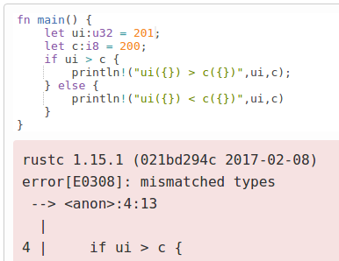
Rust vs C typing errors
201 > 200?
#include <stdio.h>
int main() {
unsigned int ui = 201;
char c=200;
if (ui > c)
printf("ui(%d) > c(%d)\n",ui,c);
else
printf("ui(%d) < c(%d)\n",ui,c);
}
mashimaro <~> 12:50PM % ./a.out
ui(201) < c(-56)

Slide 19
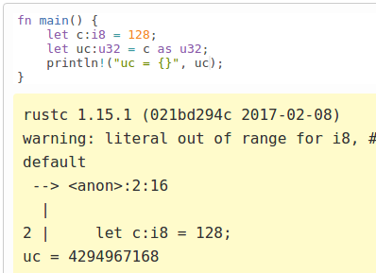
Rust vs C typing errors
In Rust, casting allowed via the “as” keyword
  Follows similar rules as C
  But, warns of literal problem before performing the promotion with sign extension
#include <stdio.h>
int main() {
char c=128;
unsigned int uc;
uc = (unsigned int) c;
printf("%x %u\n",uc, uc);
}
mashimaro <~> 1:24PM % ./a.out
ffffff80 4294967168

Slide 20
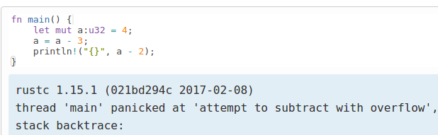
Rust vs C typing errors
Recall issues with unchecked underflow and overflow
  Silent wraparound in C
  Run-time check in Rust
int main() {
unsigned int a = 4;
a = a - 3;
printf("%u\n",a-2);
}
mashimaro <~> 9:35AM % ./a.out
4294967295

Slide 21
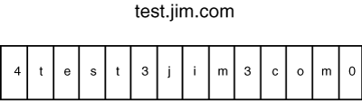
Recall previous C vulnerability
DNS parser vulnerability
  count read as byte, then count bytes concatenated to nameStr
char *indx;
int count;
char nameStr[MAX_LEN]; //256
...
memset(nameStr, '\0', sizeof(nameStr));
...
indx = (char *)(pkt + rr_offset);
count = (char)*indx;
while (count){
(char *)indx++;
strncat(nameStr, (char *)indx, count);
indx += count;
count = (char)*indx;
strncat(nameStr, ".“, sizeof(nameStr) – strlen(nameStr));
}
nameStr[strlen(nameStr)-1] = '\0';
What if count = 128?
Sign extended then used in strncat
Type mismatch in Rust
char *strncat(char *dest, const char *src, size_t n);
http://www.informit.com/articles/article.aspx?p=686170&seqNum=6

Slide 22
Another C vulnerability
2002 FreeBSD getpeername() bug (B&O Ch. 2)
  Kernel code to copy hostname into user buffer
    copy_from_kernel() call takes signed int for size from user
    memcpy call uses unsigned size_t
  What if adversary gives a length of “-1” for his buffer size?
#define KSIZE 1024
char kbuf[KSIZE]
void *memcpy(void *dest, void *src, size_t n);
int copy_from_kernel(void *user_dest, int maxlen){
/* Attempt to set len=min(KSIZE, maxlen) */
int len = KSIZE < maxlen ? KSIZE : maxlen;
memcpy(user_dest, kbuf, len);
return len;
}
Type mismatch in Rust
  (KSIZE < -1) is false, so len = -1
  memcpy casts -1 to 2³²-1
  Unauthorized kernel memory copied out

Slide 23
Rust’s Ownership & Borrowing
Compiler enforced:
Every resource has a unique owner.
Others can borrow the resource from its owner (e.g. create an alias) with restrictions
Owner cannot free or mutate its resource while it is borrowed.
Aliasing
Mutation
No need for runtime
Memory safety
Data-race freedom

Slide 24
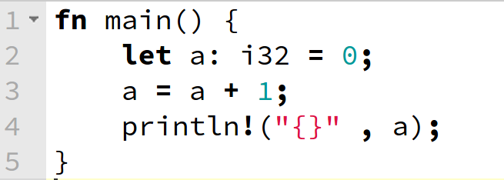
But first…mutability
By default, Rust variables are immutable
  Usage checked by the compiler
mut is used to declare a resource as mutable.
fn main() {
let mut a: i32 = 0;
a = a + 1;
println!("{}" , a);
}
http://is.gd/OQDszP
rustc 1.14.0 (e8a012324 2016-12-16)
error[E0384]: re-assignment of immutable variable `a`
--> <anon>:3:5
|
2 | let a: i32 = 0;
| - first assignment to `a`
3 | a = a + 1;
| ^^^^^^^^^ re-assignment of immutable variable
error: aborting due to previous error
rustc 1.14.0 (e8a012324 2016-12-16)
1
Program ended.

Slide 25
Ownership and lifetimes
There can be only one “owner” of an object
  When the “owner” of the object goes out of scope, its data is automatically freed
  Can not access object beyond its lifetime (checked at compile-time)
struct Dummy { a: i32, b: i32 }
fn foo() {
let mut res = Box::new(Dummy {
a: 0,
b: 0
});
res.a = 2048;
}
Memory allocation
Resource owned by res is freed automatically
owns
.a = 2048
.a = 0
res
.b = 0
Heap
Stack

Slide 26
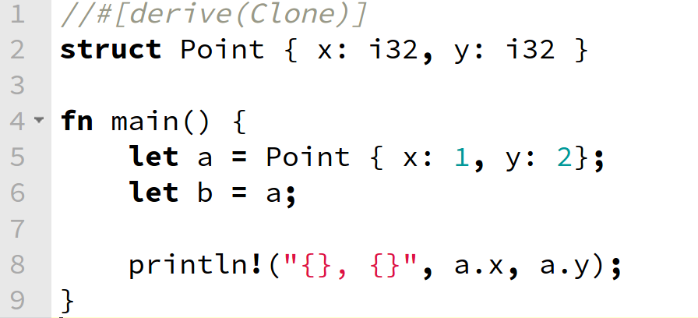
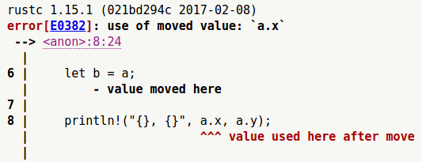
Assignment changes ownership
http://is.gd/pZKiBw

Slide 27
Ownership transfers in function calls
struct Dummy { a: i32, b: i32 }
fn foo() {
let mut res = Box::new(Dummy {
a: 0,
b: 0
});
take(res);
println!(“res.a = {}”, res.a);
}
fn take(arg: Box<Dummy>) {
}
Compiler Error!
Ownership is moved from res to arg
arg is out of scope and the resource is freed automatically

Slide 28
Borrowing
You can borrow ownership of an object using the & operator in order to modify it (with some restrictions)
  You cannot borrow mutable reference from immutable object
    Or mutate an object immutably borrowed
  You cannot borrow more than one mutable reference (to support atomicity)
    You can borrow an immutable reference many times
  There cannot exist a mutable reference and an immutable one simultaneously (removes race conditions)
  The lifetime of a borrowed reference should end before the lifetime of the owner object does (removes use after free)

Slide 29
Borrowing example (&)
You cannot borrow mutable reference from immutable object
struct Dummy { a: i32, b: i32 }
fn foo() {
let res = Box::new(Dummy{a: 0, b: 0});
res.a = 2048;
let borrower = &mut res;
}
Error: Resource is immutable
Error: Cannot get a mutable borrowing
of an immutable resource

Slide 30
Borrowing example (&)
You cannot mutate an object immutably borrowed
struct Dummy { a: i32, b: i32 }
fn foo() {
let mut res = Box::new(Dummy{
a: 0,
b: 0
});
take(&res);
res.a = 2048;
}
fn take(arg: &Box<Dummy>) {
arg.a = 2048;
}
Resource is returned from arg to res
Resource is immutably borrowed by arg from res
Compiler Error: Cannot mutate via
an immutable reference
Resource is still owned by res. No free here.

Slide 31
Borrowing example (&mut)
You cannot borrow more than one mutable reference
Aliasing
Mutation
struct Dummy { a: i32, b: i32 }
fn foo() {
let mut res = Box::new(Dummy{a: 0, b: 0});
take(&mut res);
res.a = 4096;
let borrower = &mut res;
}
fn take(arg: &mut Box<Dummy>) {
arg.a = 2048;
}
Mutably borrowed by arg from res
Multiple mutable borrowings
are disallowed
let alias = &mut res;
Returned from arg to res

Slide 32
Immutable, shared borrowing (&)
You can borrow more than one immutable reference
  But, there cannot exist a mutable reference and an immutable one simultaneously
Aliasing
Mutation
struct Dummy { a: i32, b: i32 }
fn foo() {
let mut res = Box::new(Dummy{a: 0, b: 0});
{
let alias1 = &res;
let alias2 = &res;
let alias3 = alias2;
res.a = 2048;
}
res.a = 2048;
}

Slide 33
Finally,
The lifetime of a borrowed reference should end before the lifetime of the owner object does

Slide 34
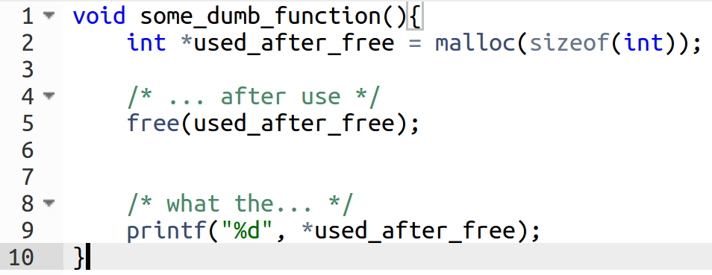
Use-after free in C
Memory allocated to int
Then freed
Then used after free
If these calls are far away from each other,
this bug can be very hard to find.

Slide 35
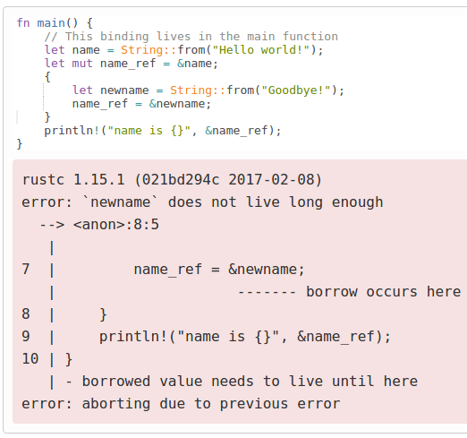
Caught by Rust at compile-time
Unique ownership, borrowing, and lifetime rules easily enforced

Slide 36
Dangling pointer in C
Recall scoping issues example (B&O Ch 3, Procedures)
  int* func(int x) {
  int n;
  int *np;
  n = x;
  np = &n;
  return np;
  }
What does np point to after function returns?
What happens if np is dereferenced after being returned?
Local variable is allocated in stack,
a temporal storage of function.
Reference returned, but variable now out
of scope (dangling pointer)
http://thefengs.com/wuchang/courses/cs201/class/08/invalid_ref.c

Slide 37
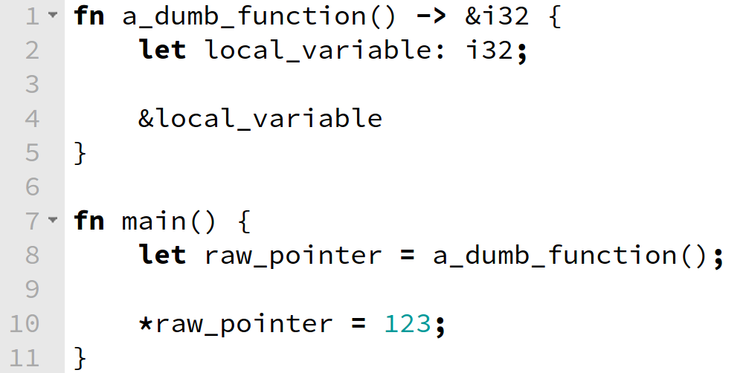
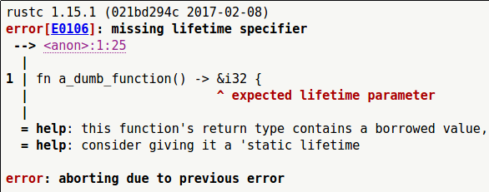
Caught by Rust at compile-time
  Ownership/Borrowing rules ensure objects are not accessed beyond lifetime
borrowed pointer
cannot outlive
the owner!!
http://is.gd/3MTsSC

Slide 38
Summary
Languages offer trade-offs in terms of performance, ease of use, and safety
  Learn to be multi-lingual
  Learn how to choose wisely

Slide 39
Sources
Haozhong Zhang “An Introduction to
Rust Programming Language”
Aaron Turon, The Rust Programming Language, Colloquium on Computer Systems Seminar Series (EE380) , Stanford University, 2015.
Alex Crichton, Intro to the Rust programming language, http://people.mozilla.org/~acrichton/rust-talk-2014-12-10/
The Rust Programming Language, https://doc.rust-lang.org/stable/book/
Tim Chevalier, “Rust: A Friendly Introduction”, 6/19/2013

Slide 40
Resources
Rust website: http://rust-lang.org/
  Playground: https://play.rust-lang.org/
  Guide: https://doc.rust-lang.org/stable/book/
  User forum: https://users.rust-lang.org/
  Book: https://doc.rust-lang.org/stable/book/academic-research.html
IRC: server: irc.mozilla.org, channel: rust
Cargo: https://crates.io/
Rust by example: http://rustbyexample.com/

Slide 41
Extra

Slide 42
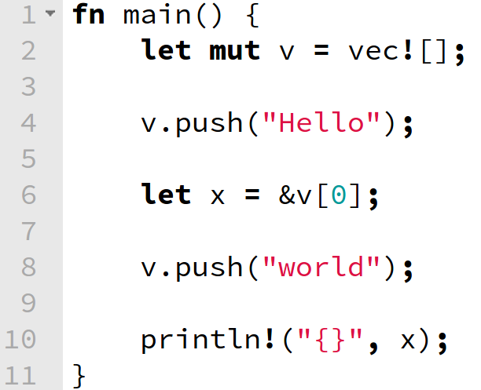
Ownership and borrowing example
v is an owner of the vector
x borrows the vector from v
now v cannot modify the vector
because it lent the ownership to x
http://is.gd/dEamuS

Slide 43
More than that …
C/C++
Haskell/Python
more control,
less safety
less control,
more safety
Rust
more control,
more safety

Slide 44
Concurrency & Data-race Freedom
struct Dummy { a: i32, b: i32 }
fn foo() {
let mut res = Box::new(Dummy {a: 0, b: 0});
std::thread::spawn(move || {
let borrower = &mut res;
borrower.a += 1;
});
res.a += 1;
}
Spawn a new thread
res is mutably borrowed
Error: res is being mutably borrowed

Slide 45
Mutably Sharing
Mutably sharing is inevitable in the real world.
Example: mutable doubly linked list
prev
prev
prev
next
next
next
struct Node {
prev: option<Box<Node>>,
next: option<Box<Node>>
}

Slide 46
Rust’s Solution: Raw Pointers
prev
prev
prev
next
next
next
struct Node {
prev: option<Box<Node>>,
next: *mut Node
}
Raw pointer
Compiler does NOT check the memory safety of most operations wrt. raw pointers.
Most operations wrt. raw pointers should be encapsulated in a unsafe {} syntactic structure.

Slide 47
Rust’s Solution: Raw Pointers
let a = 3;
unsafe {
let b = &a as *const u32 as *mut u32;
*b = 4;
}
println!(“a = {}”, a);
I know what I’m doing
Print “a = 4”

Slide 48
Unsafe
Life is hard.

Slide 49
Foreign Function Interface (FFI)
All foreign functions are unsafe (e.g. libc calls)
extern {
fn write(fd: i32, data: *const u8, len: u32) -> i32;
}
fn main() {
let msg = b”Hello, world!\n”;
unsafe {
write(1, &msg[0], msg.len());
}
}

Slide 50
Inline Assembly is unsafe
#![feature(asm)]
fn outl(port: u16, data: u32) {
unsafe {
asm!(“outl %0, %1”
:
: “a” (data), “d” (port)
:
: “volatile”);
}
}

